Slide 1


On Stochastic Stability of Deep Markov Models
DLC, April 8, 2021
Jan Drgona (PNNL), Sayak Mukherjee (PNNL),
Jiaxin Zhang (ORNL), Frank Liu (ORNL),
Mahantesh Halappanavar (PNNL)

Slide 2
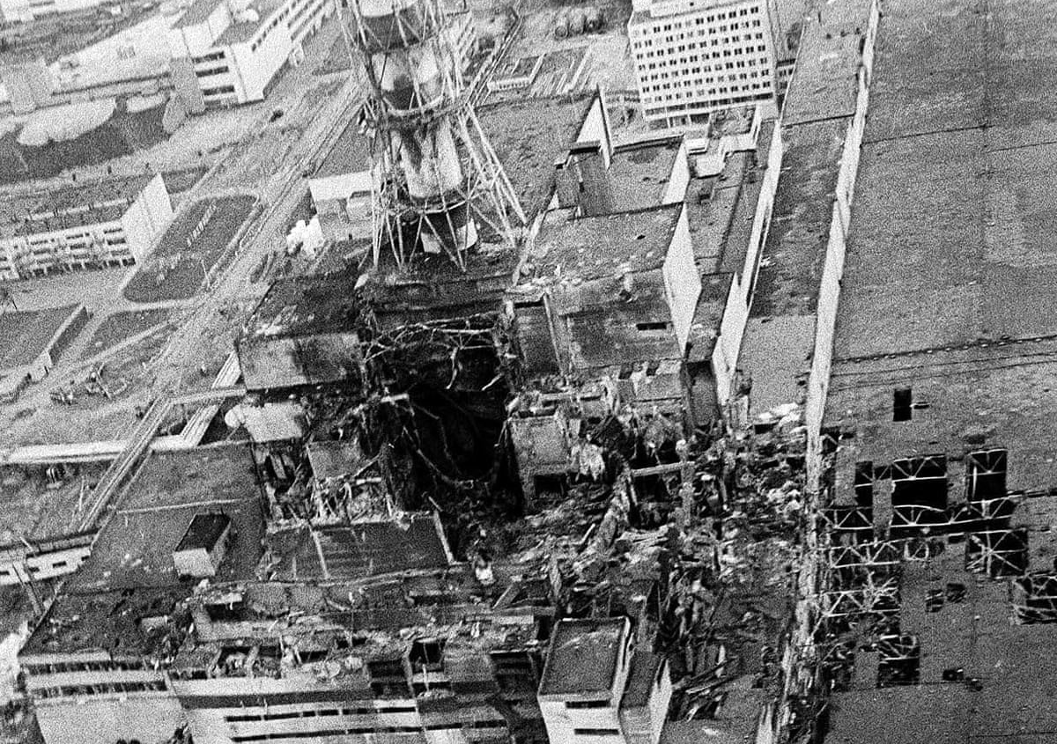
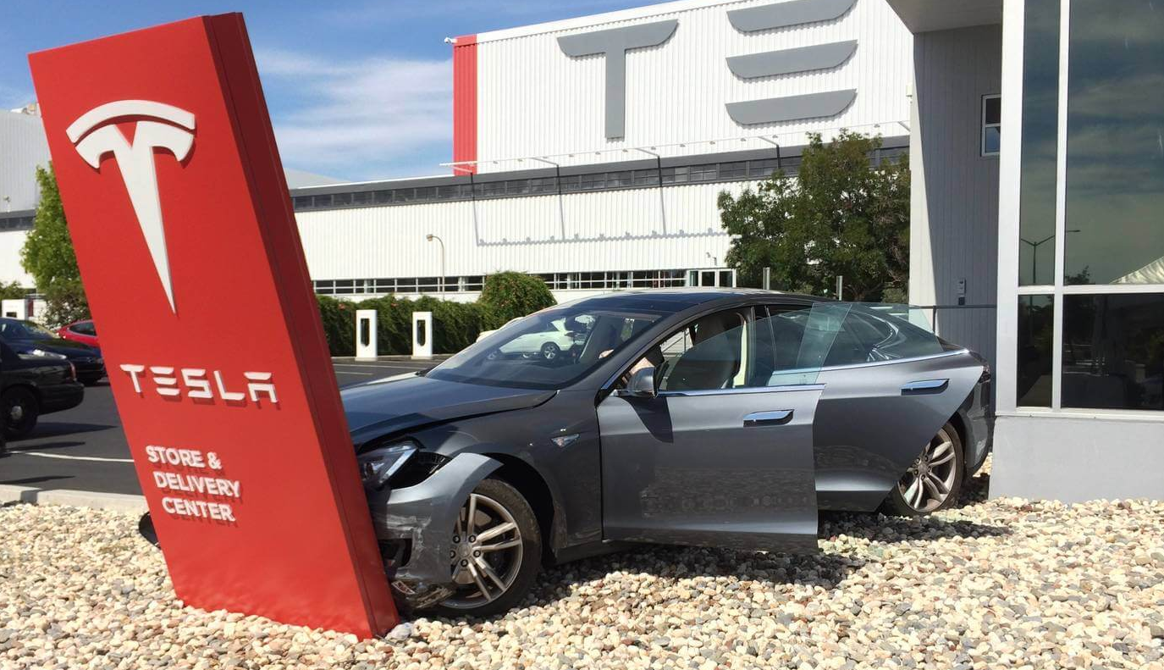

Stability Analysis of Deep Markov Models
Motivation
Safety-critical systems call for formal verification methods to ensure safe operation.
Properties like stability and robustness are crucial for reliable modeling and control.
Objectives
Sufficient conditions for stochastic stability of deep Markov models (DMMs).
Approaches
Apply system-theoretic analysis methods on DMMs.
Real-world consequences of unstable systems.
Reactors
Autonomous cars
Rocket landing

Slide 3
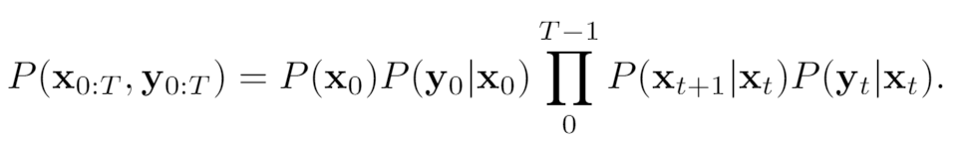
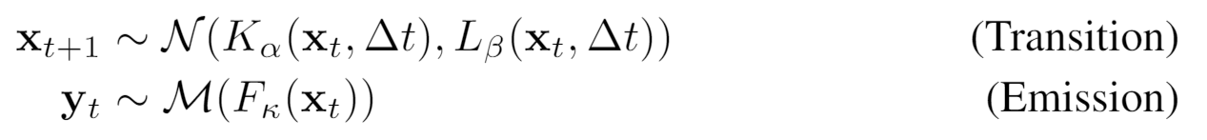
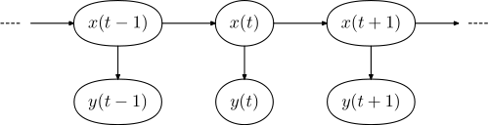
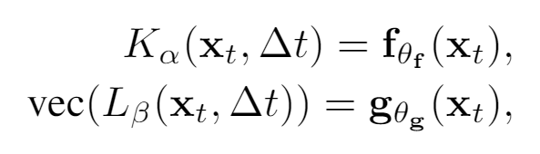
Deep Markov Models
https://en.wikipedia.org/wiki/Hidden_Markov_mode
Deep Markov Models:
Probabilistic graphical model (PGM)
Generative model of sequential data
Applications:
Economics, finance
Pattern recognition
Signal processing
Exploring connections between:
Stability of stochastic systems
Deep Markov models (DMMs)
Contraction of DMM transitions
Operator norms
Banach fixed point theorem

Slide 4
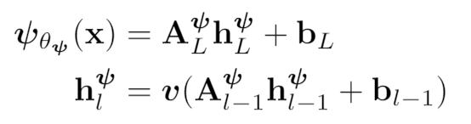
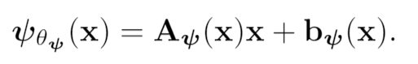

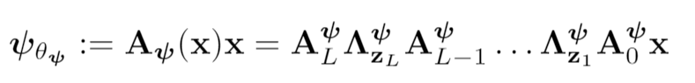
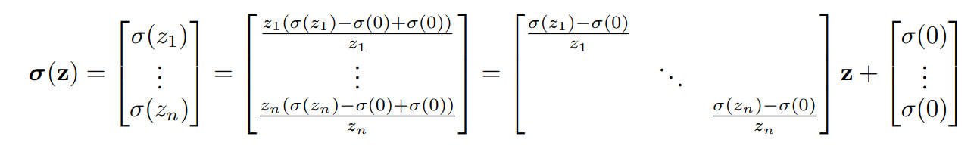
Deep Neural Networks as Piecewise Affine Maps
DNN
PWA map
Local linear dynamics of DNN
At every point , DNN can be represented as a product of PWA maps:
PWA activation map

Slide 5
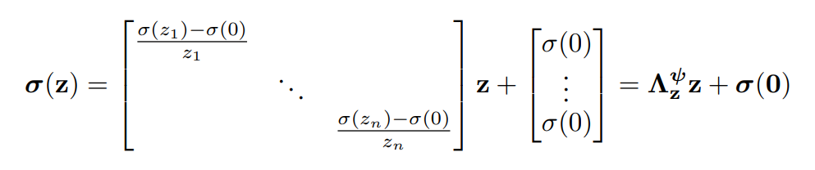
Deep Neural Networks as Piecewise Affine Maps
DNN
PWA map
Local linear dynamics of DNN
At every point , DNN layer can be represented as:
PWA activation map

Slide 6
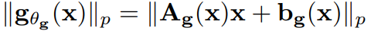
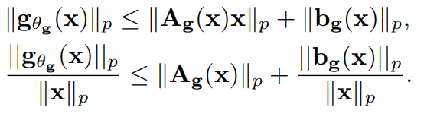
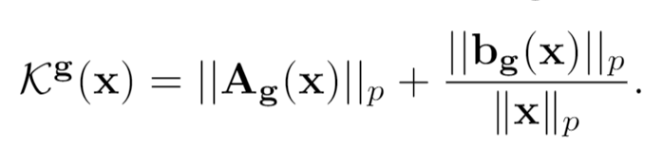
Local Lipschitz Constants of Deep Neural Networks
Neural Network PWA operator norm:
Triangle inequality:
Local Lipschitz constant of DNN:

Slide 7
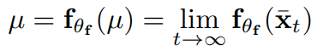
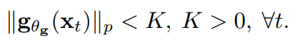
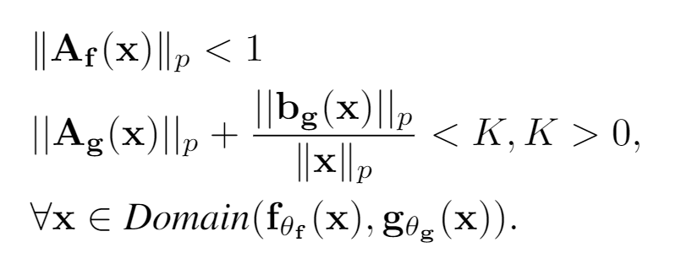
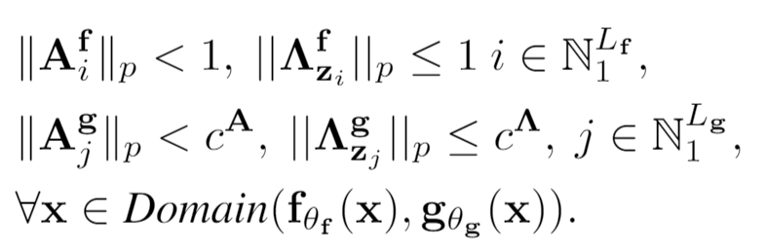
Stochastic Stability of Deep Markov Models
Converging mean and bounded variance:
Sufficient stability conditions of DMM:
Local Lipschitz constant of DNN:
Contractive weights and
activations imply DMM stability:

Slide 8
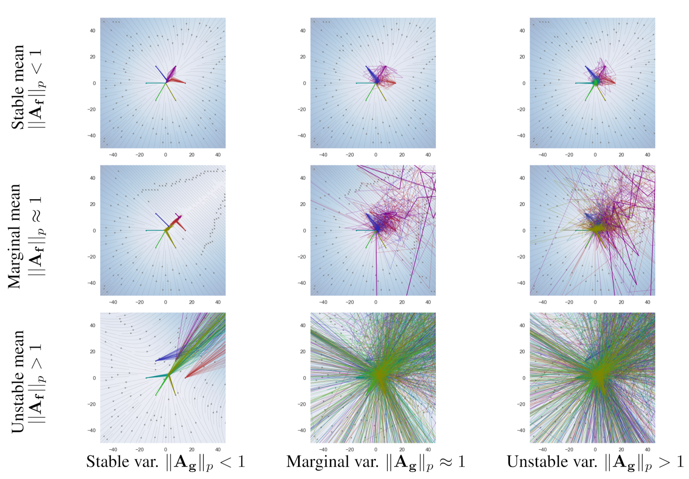
Effect of Mean and Variance on Stochastic Stability of Deep Markov Models

Slide 9
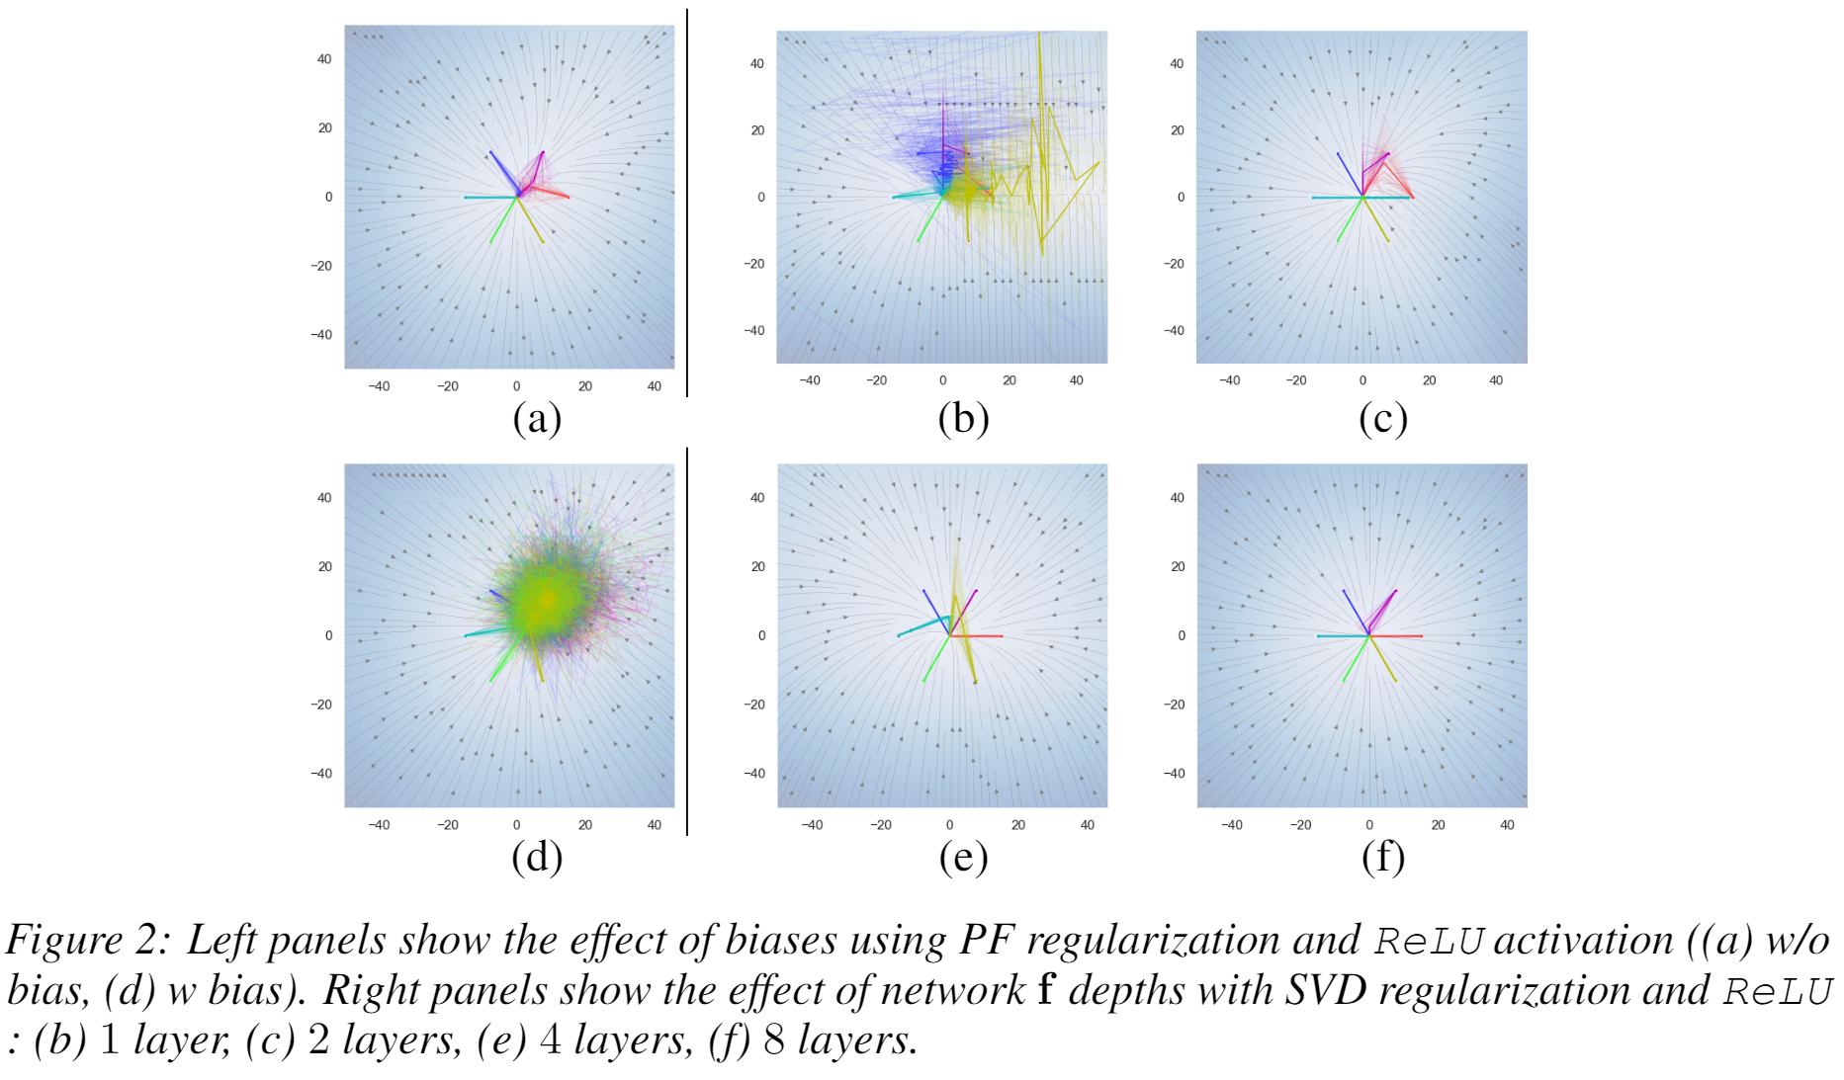
Effect of Biases and Depth on the Stability of Deep Markov Models

Slide 10
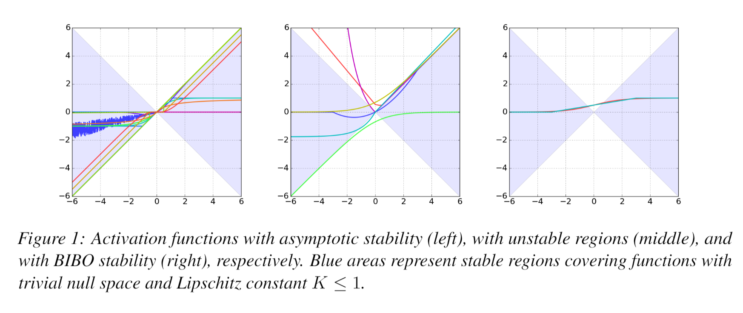
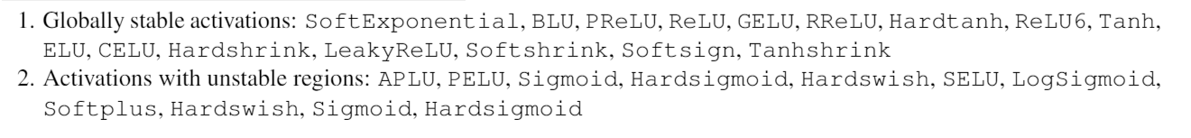
Stability of Activation Functions

Slide 11
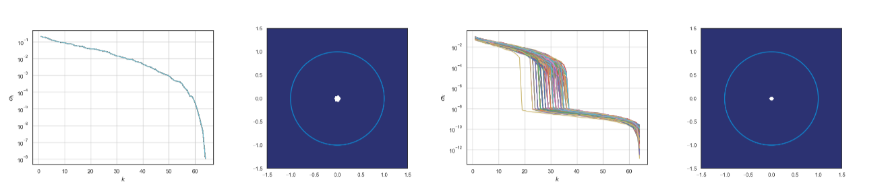
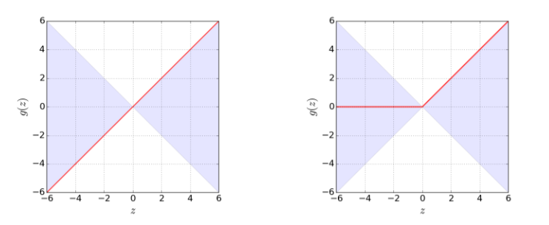
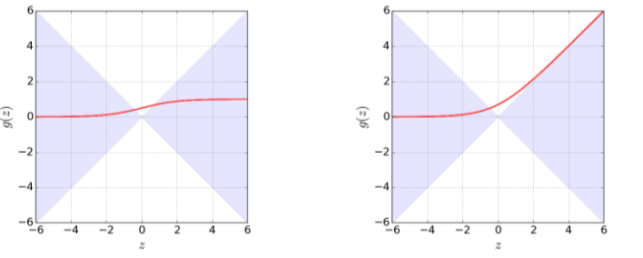
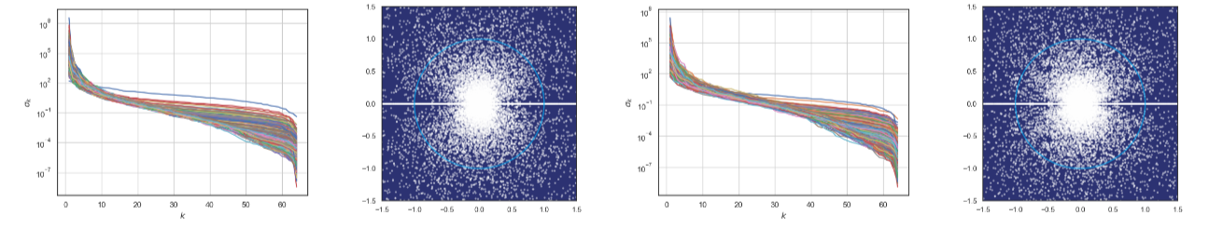
Nonlinearity of Deep Neural Networks with Different Activation Functions
Identity
ReLU
Identity
ReLU
Sigmoid
SoftExponential
Sigmoid
SoftExponential

Slide 12
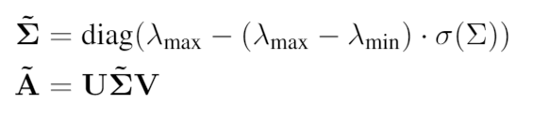
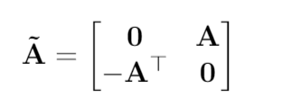
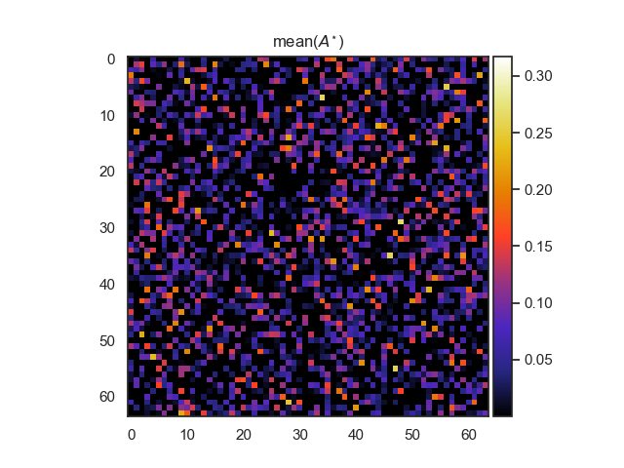
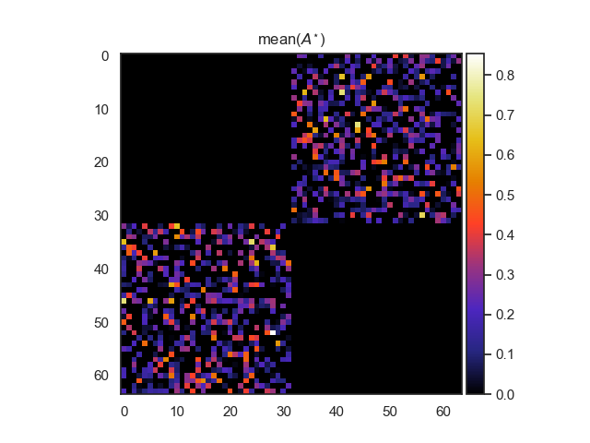
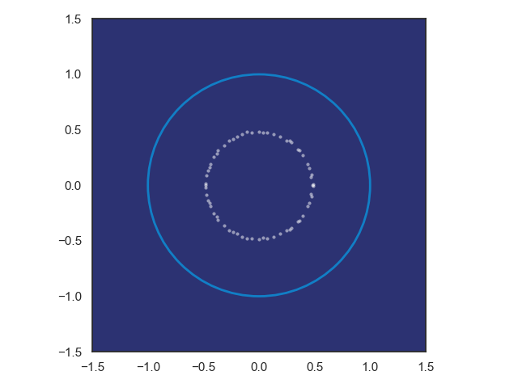
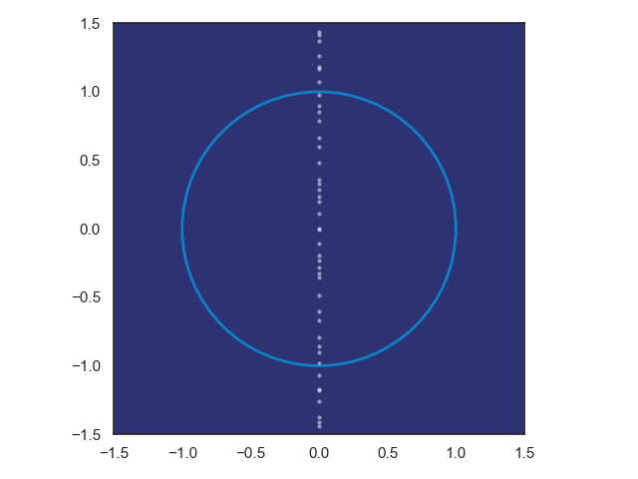
Practical Stability Constraints for DNN and DMM
SVD factorization
Hamiltonian weight
Pytorch implementation: https://github.com/pnnl/slim
SLIM: Drop-in replacements for PyTorch nn.Linear for stable learning and inductive priors.
Jiong Zhang, et al., Stabilizing Gradients for Deep Neural Networks via Efficient SVD Parameterization, 2018. Eldad Haber and Lars Ruthotto, Stable Architectures for Deep Neural Networks 2017

Slide 13
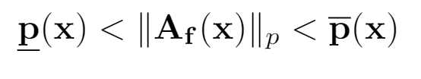
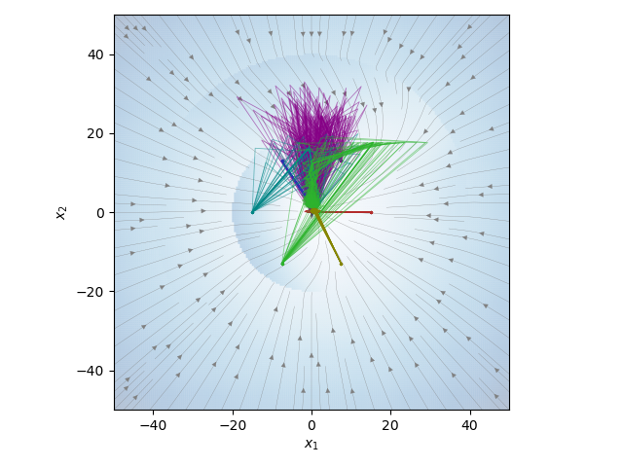
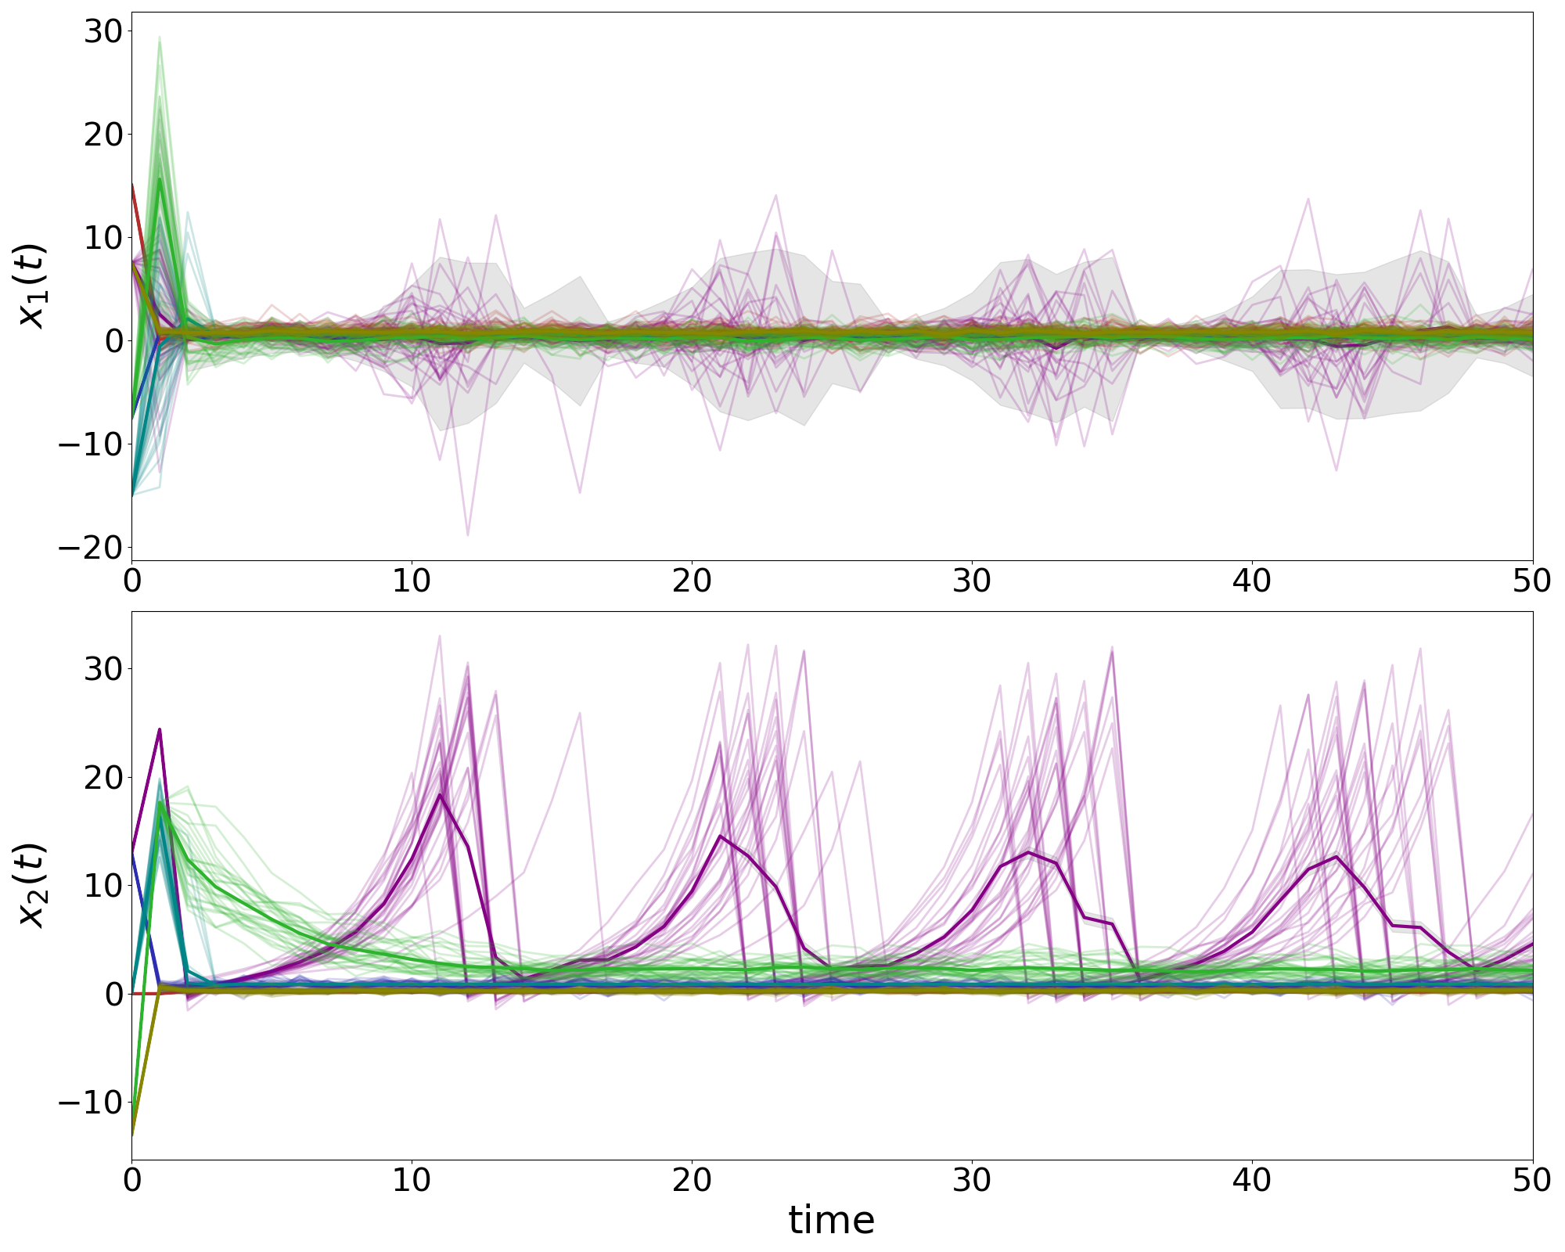
Parametric Stability Constraints for DMMs
Constrained operator norms of DMMs:

Slide 14
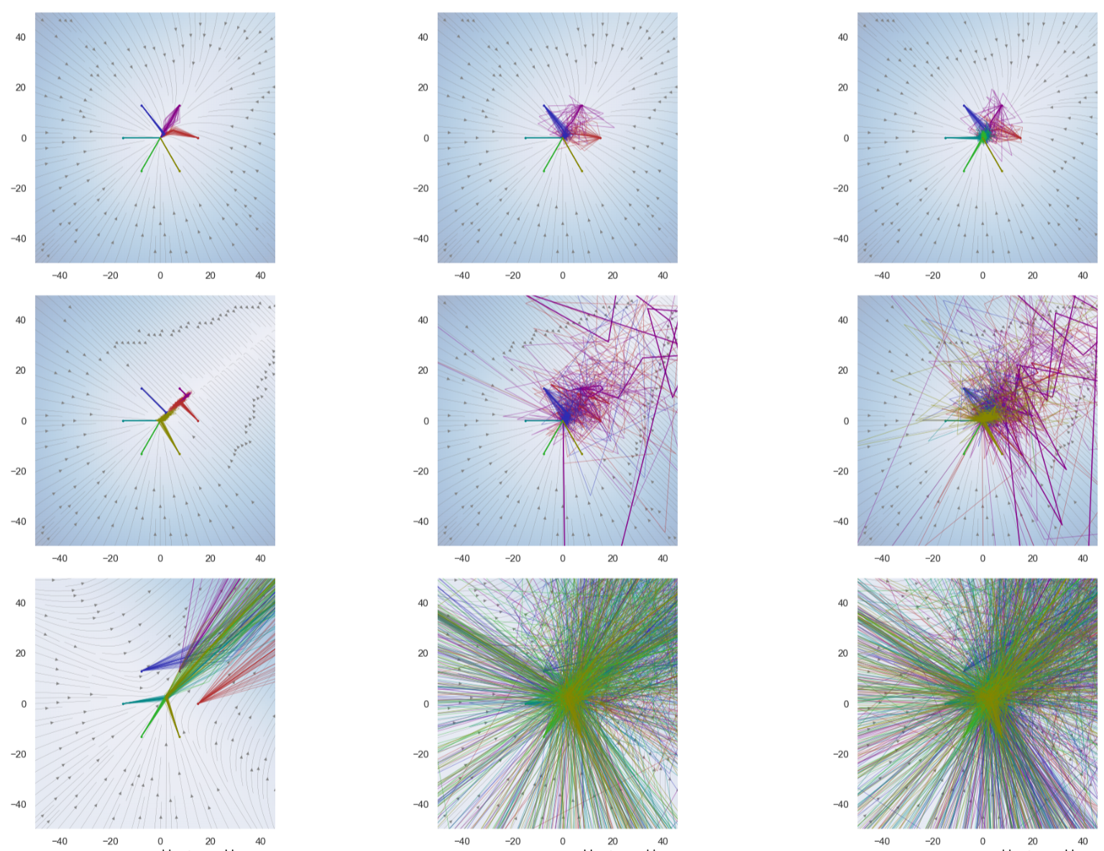
Conclusion
Stability of Deep Markov Models
Neural Networks as PWA maps
Contraction of PWA maps
Banach fixed point theorem
Operator norm constraints
Contraction of DMMs
Stable Weights
Structured linear maps in Pytorch
https://pnnl.github.io/slim/
Contact
jan.drgona@pnnl.gov
https://www.linkedin.com/in/drgona/
https://twitter.com/jan_drgona
Jan Drgona, Sayak Mukherjee, Jiaxin Zhang, Frank Liu, Mahantesh Halappanavar, On the Stochastic Stability of Deep Markov Models, NeurIPS 2021

